Slide 1
Messaging
CMPE 273

Slide 2
Integration Styles Review
File Transfer (Pull)
Shared Database (Read/Write)
RPC and Web Services (Request-Reply)
Messaging (Point-to-Point or Pub-Sub)
Notes:
Pub-Sub: Point a to multiple destination

Slide 3
App Integration Criteria
Application coupling – minimize dependencies
Integration simplicity – the less integration code is the better
Integration technology – open source vs. proprietary
Data format – data format evolution and extensibility
Data timeliness 及时性 – latency in data sharing between apps.
Asynchronicity – the sender and receiver can process independently

Slide 4
What is Messaging?
A method of communication between applications.
Enables loose coupling among applications by communicating asynchronously.
More reliable because the sender and receiver do not have to be running at the same time.
The sender doesn’t need to know about the receiver; nor does the receiver need to know about the sender.

Slide 5
Components
Message Producer and Consumer
Queue
Topic
Broker 代理人 (and Broker-less?)

Slide 6
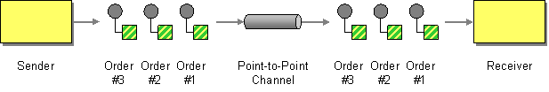
Point-to-Point Channel

Slide 7
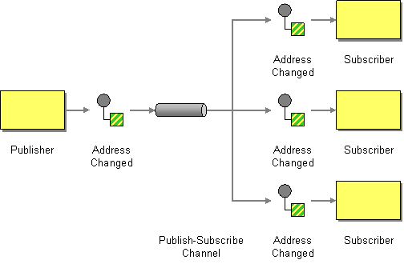
Publish-Subscribe Channel
Notes:
The first address will copy to the another three address .

Slide 8
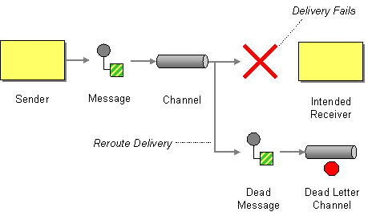
Dead Letter Queue (DLQ)

Slide 9
Message Persistence
In-memory queue
Persistent queue
Transaction support
Time to Live setting

Slide 10
Major Messaging Protocols
Java Messaging Service (JMS)
Advanced Message Queuing Protocol (AMQP)
Simple Text Oriented Messaging Protocol (STOMP)
MQTT

Slide 11
What is STOMP?
STOMP is a Simple Text-Oriented Messaging Protocol similar to HTTP.
HTTP for the messaging realm.
Interoperable wire format unlike JMS or AMQP
Very easy to implement and flexible—language-agnostic like REST.

Slide 12
STOMP Message Frame
COMMAND
HEADER..1
HEADER..2
HEADER..n
BODY
MESSAGE
subscription:required-for-STOMP-1.1
content-length:11
message-id:ID\cmybroker-21-0
destination:/topic/event
id:1380736870570
transformation:TEXT_NULL
Hello World

Slide 13
Messaging Servers
Name | Protocol Support | Language Support
ActiveMQ | JMS, OpenWire, STOMP, AMQP, MQTT, WebSockets | Mainly Java, C#, C, C++
Kafka | Integrate with other protocols via Kafka Connect | *
RabbitMQ | AMQP and STOMP | *
ZeroMQ | A Socket Library | *
CoilMQ | STOMP | Python only
Mosquitto | MQTT | *
Redis Pub/Sub | Redis protocol | *

Slide 14
Broker-based (MOM) Architecture
Classical “star” or “hub and spoke” architecture.
Every app is connected to the central broker.
No point-to-point direct communication between apps.
All the communication is passed through through the broker.

Slide 15
Advantages of Broker-based Architecture
Location transparency – apps don’t need to know about location of other apps except the broker address.
Broker routes the messages to the right applications based on queue name, topic, and message properties rather than on physical IP/hostname addresses.
Sender can push messages to the broker and terminate and receiver can consume the messages any time later.

Slide 16
Disadvantages of Broker-based Architecture
Requires excessive amount of network communication.
The broker now becomes the bottleneck of the whole system.
The broker instance can be utilized to 100% of resources while application instances are under-utilized, even idle most of the time.
Worst use case for implementing request/reply or RPC (remote procedure call) paradigm.

Slide 17
Broker-less Architecture
Applications send messages each other without the broker in the middle.
Applications have to know the network address of other applications.
Ideal for apps with a need for low latency and/or high transaction rate.

Slide 18
Advantages of Broker-less Architecture
Fewer number of network hops among applications.
No single bottleneck on the network.
Faster response time for request-reply paradigm.

Slide 19
Disadvantages of Broker-less Architecture
No location transparency
Poor manageability of the system due to many point-to-point interconnected applications.
Less fault-tolerant
Lower total system uptime since all applications need to be up in running.

Slide 20
Broker-less with a Directory Service Architecture
Location transparency since the directory service hides the physical location of the applications.
Better manageability of the system since each application has to register in the directory service.
Message transfer is still done by applications themselves.
High performance and manageability at the same time.

Slide 21
Event-Driven Architecture (EDA)

Slide 22
Two Types of Topology 分类法 in EDA
Broker Topology
Mediator Topology

Slide 23
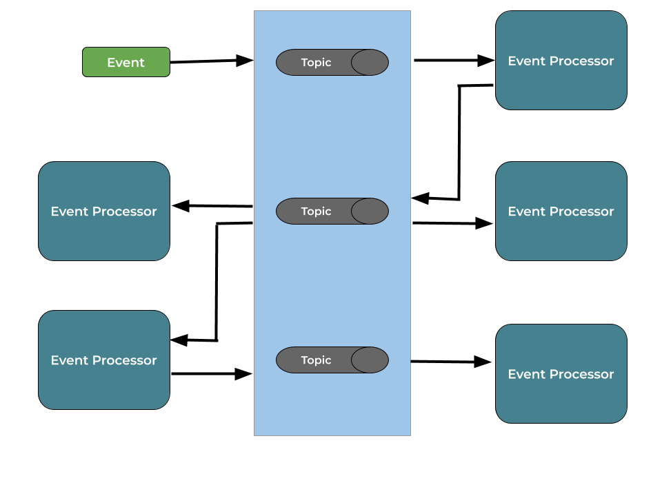
Broker Topology

Slide 24
Broker Topology
Advantages
Supports full parallelism.
Disadvantages/challenges
How do you handle the event coordination?
How about error handling in the event processors?

Slide 25
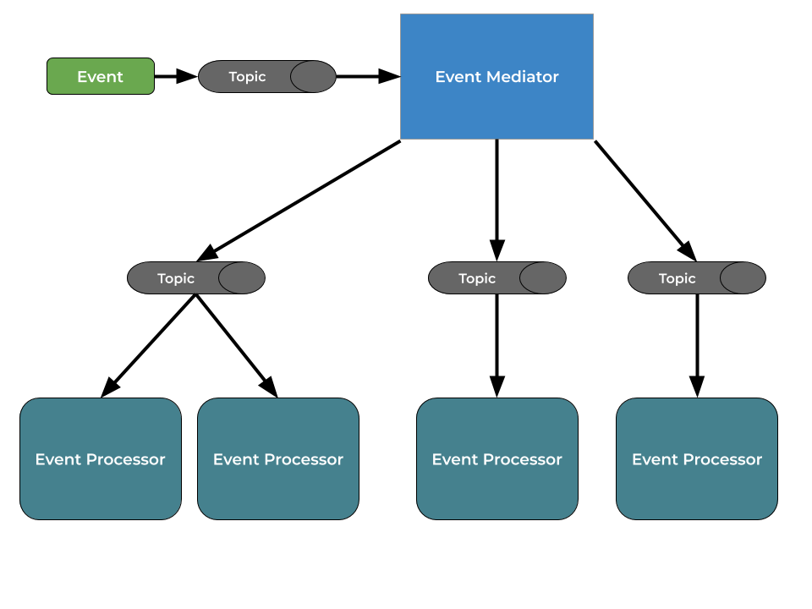
Mediator 调解人 Topology

Slide 26
Mediator Topology
Advantages
Since all messages go to the mediator, it is easy to handle errors.
The mediator knows state of each event.
Unified processing or batching is easier.
Disadvantage/challenge
Requires to change the mediator when you want to add new process.

Slide 27
CQRS

Slide 28
CQRS
Stands for Command Query Responsibility Segregation as know as Event sourcing.
Created by Greg Young.
The main goal is to use different model to update information than the model you use to read information.
Separate system of records from reporting: Separate READ and WRITE.

Slide 29
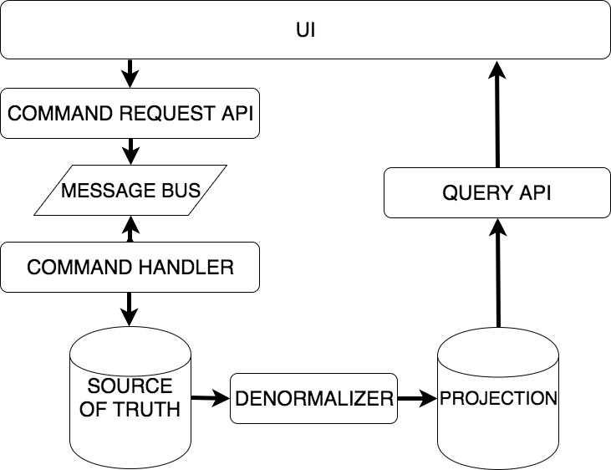
CQRS

Slide 30
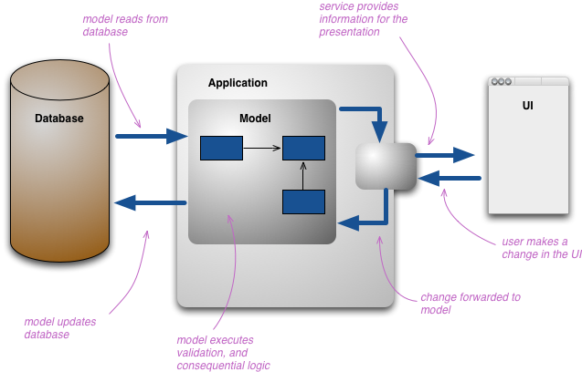
Typical 3-Tier Architecture

Slide 31
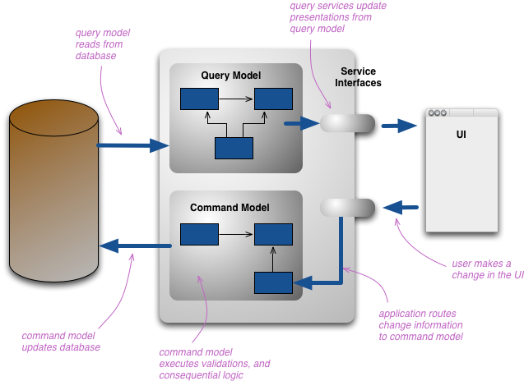
CQRS Architecture

Slide 32
CQRS
Advantages
Better modularization in a system by dividing READ and WRITE flows.
Easier to scale independently.
Disadvantages
Adds risky complexity to most systems.
No transaction support.
Eventual consistency if latency grows between writer DB and reader DB.

